Slide 1

Automatic Measurement System for Cargo Volume
Design Review III
Sponsor: Panasonic Mentor: Zhuosi Zhang Instructor: Mingjian Li
Presented by Group 17

Slide 2





Team Introduction
Team Members:
Zesen Wang (Leader)
JI ECE + KTH ML
Xinyi Wu
JI ECE + UM DS
Yier Zhang
JI ECE + UM EE
Yetong Zhang
JI ME + UM CE
Zitao Zhang
JI ECE + KTH ML

Slide 3
Background Recap
Motivation: The growing e-market in China results in the quickly expanding demand of cargo delivery. Many companies have demands on:
Fast packing and loading process
Efficient usage of vehicle capacity
Accurate freight calculation

Slide 4
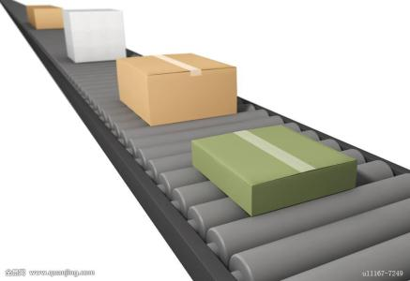
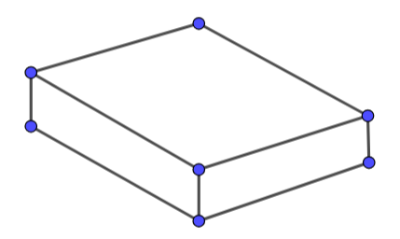
Customer Requirements
Projective:
Accurate measurement of the volume of goods on a conveyor belt
Automatic running
Standardized measurement process
Easy to build, install and use
Low-cost
Expected outcome:
Volume of the goods
3-D model map of the goods
Image Referenece: https://ss0.bdstatic.com/70cFuHSh_Q1YnxGkpoWK1HF6hhy/it/u=3831402330,1049417822&fm=200&gp=0.jpg

Slide 5
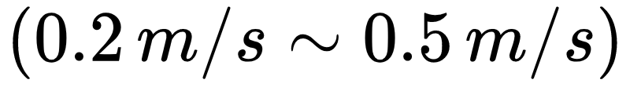
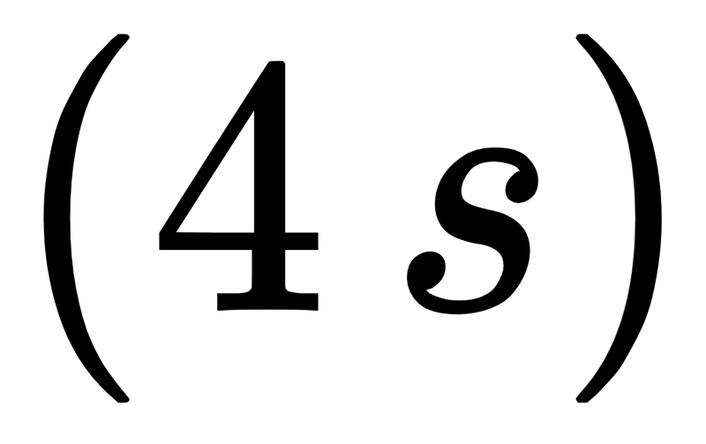
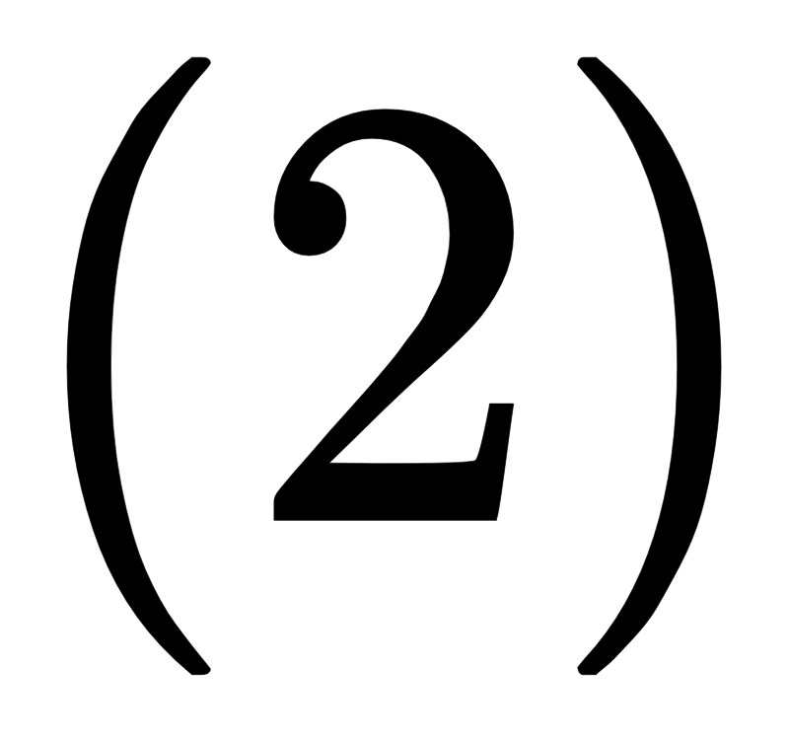
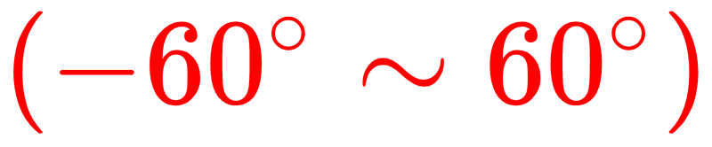
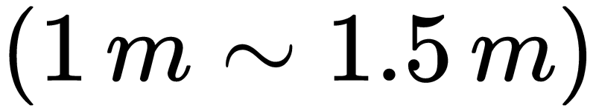
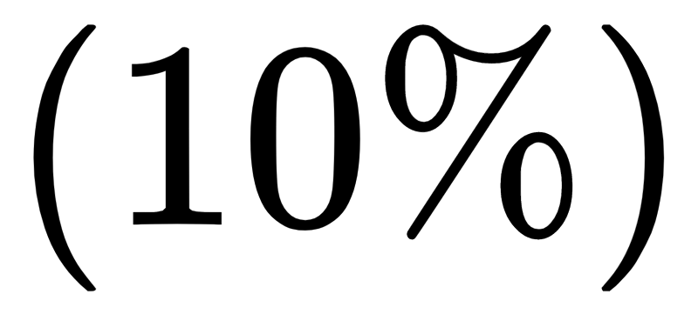
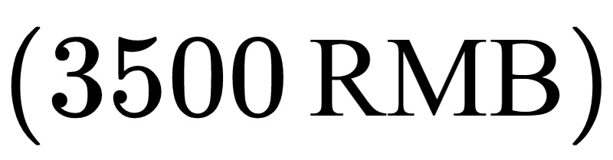
Engineering Specification
Background
Speed of conveyor belt
Cargo size range
Processing time
Design Detail
Number of depth cameras
Filming angle range
Camera distance
Technical Objective
Max unilateral error
Cost restriction

Slide 6
Our Solution
Two depth cameras -> Depth images and IR images
Reflection tape -> Locating the cargo
Extract point clouds from depth images
Align and combine point clouds from one camera
Combine point clouds from two cameras

Slide 7
Functional Decomposition
Mechanical Structures:
Conveyor belt & reflection tape
Cameras & supports
Software Parts:
Point cloud generation & background elimination
Cargo detection
Coordinate conversion & point cloud alignment
Volume estimation
3-D model output

Slide 8
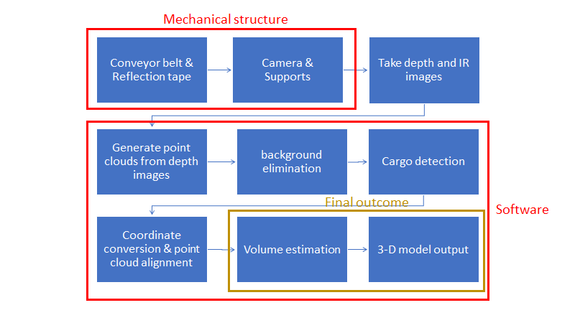
Function Flow Chart

Slide 9
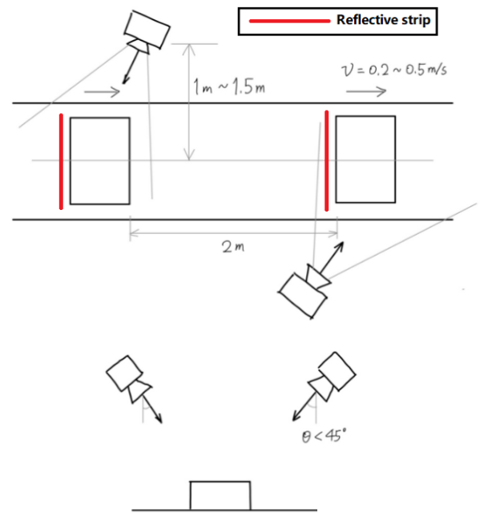
Chosen Concept
Top view
Side view

Slide 10
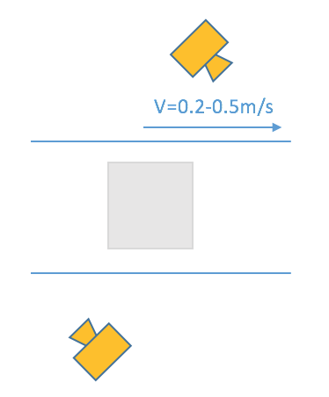
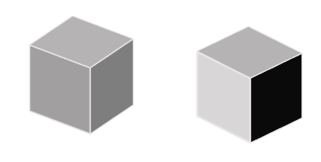
Design - Camera Positions

Slide 11
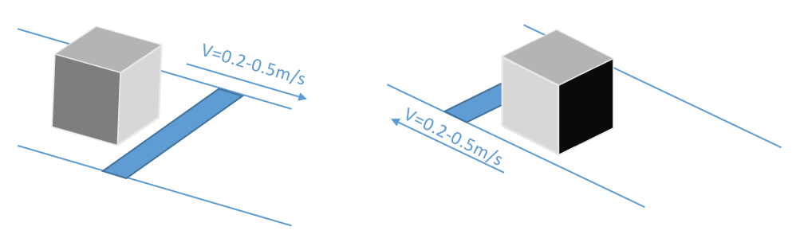
Design - Reflection Tape

Slide 12
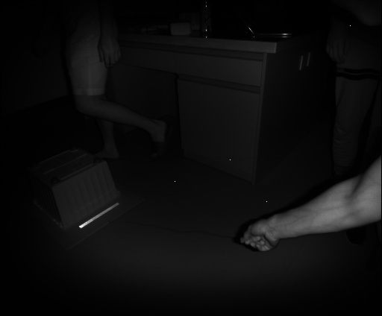
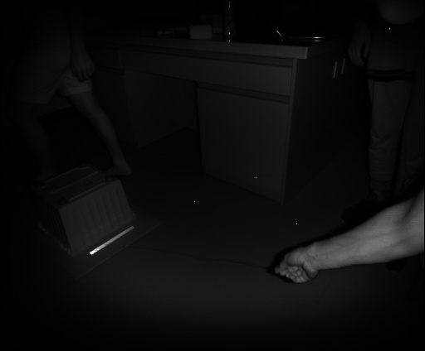
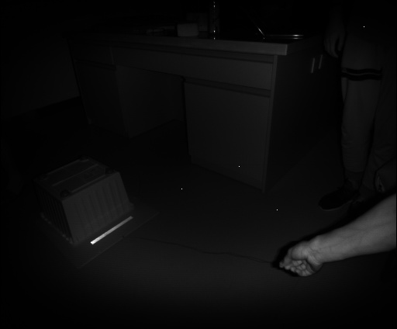
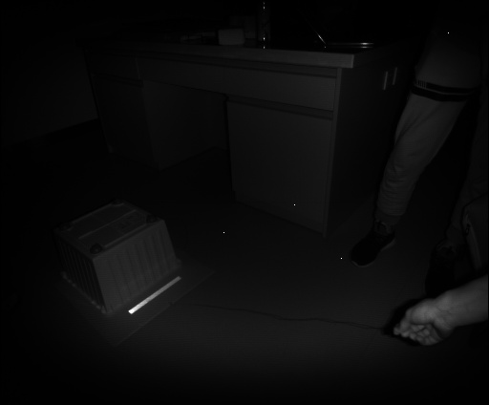
Design - Aligning Method

Slide 13
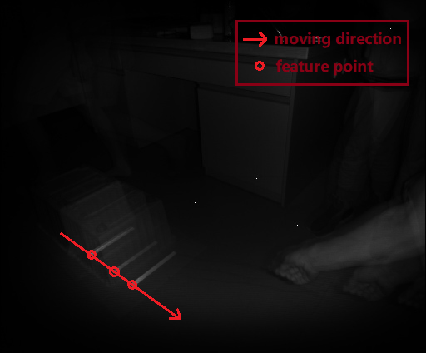
Design - Aligning Method

Slide 14
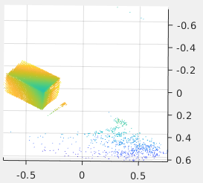
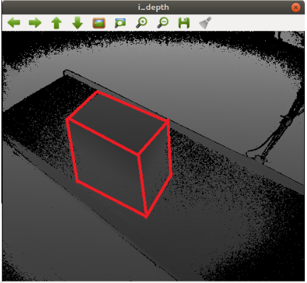
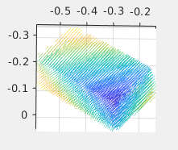
Design - Denoising

Slide 15
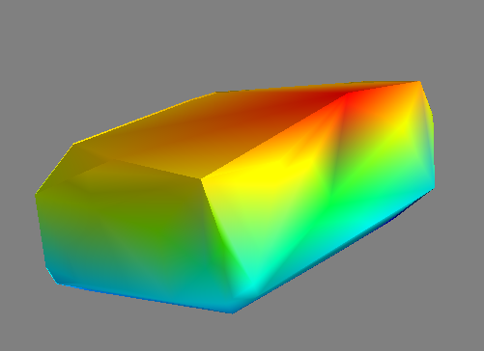
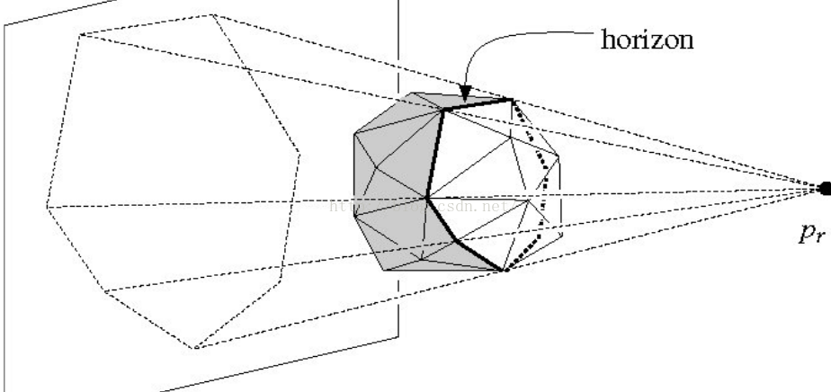
Design - Convex Hull Construction
Random Incremental Algorithm
https://blog.csdn.net/theArcticOcean/article/details/50646428

Slide 16
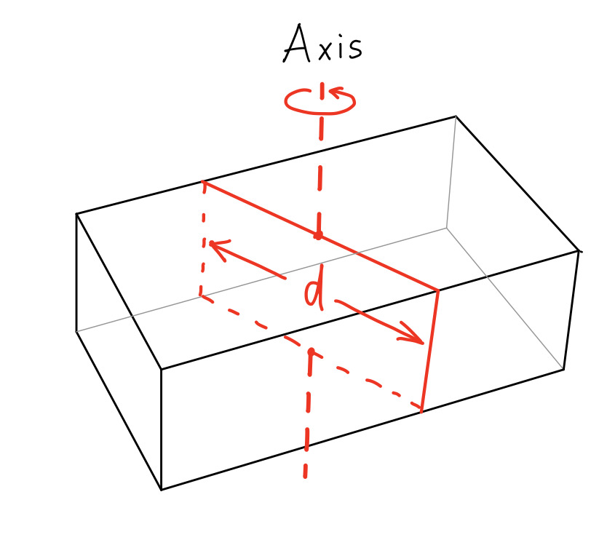
Design - Volume Estimation
Shape Detection - Length & width Recognition
Choose the Axis pass through the center of weight
Get the length d among the cross section
Rotate the cross section to get a couple of d s
The width vector is on the surface of cross section with minimum d
Get the length vector which is perpendicular to width

Slide 17
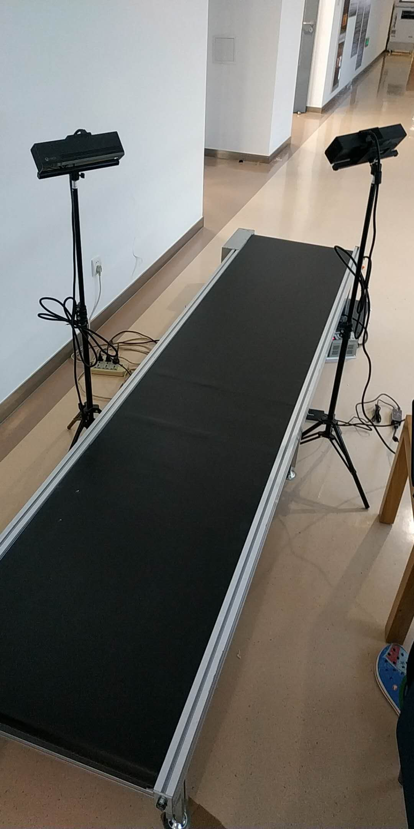
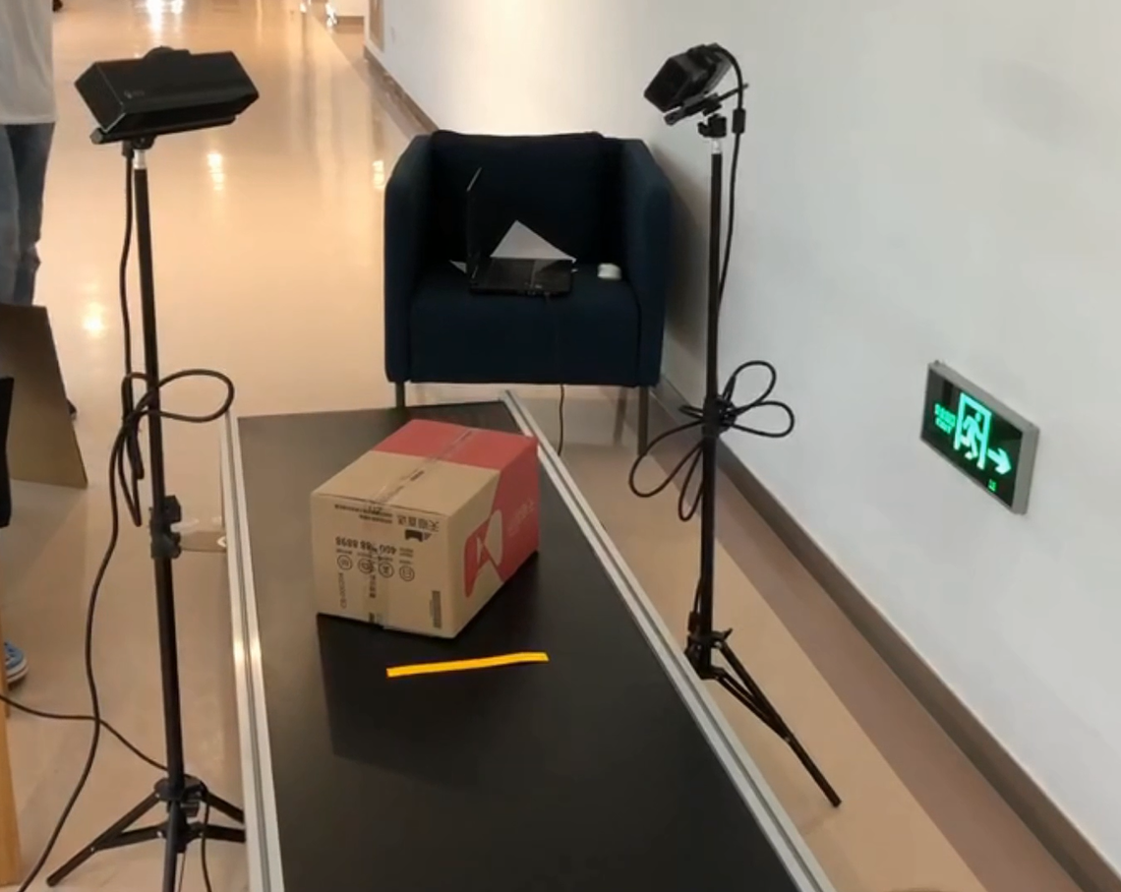
Quality Assessment
Project Photo:

Slide 18
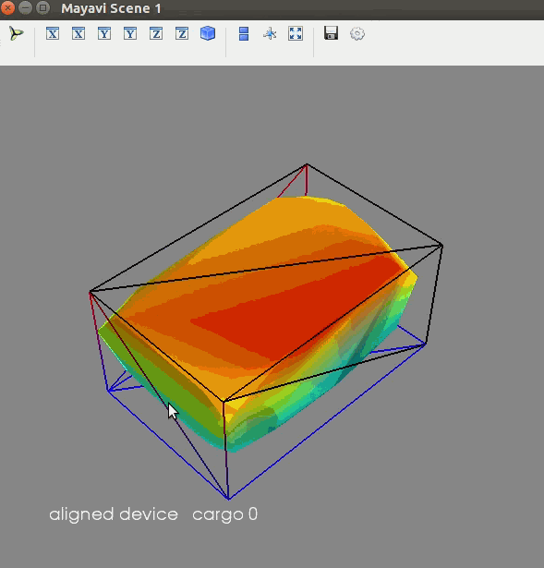
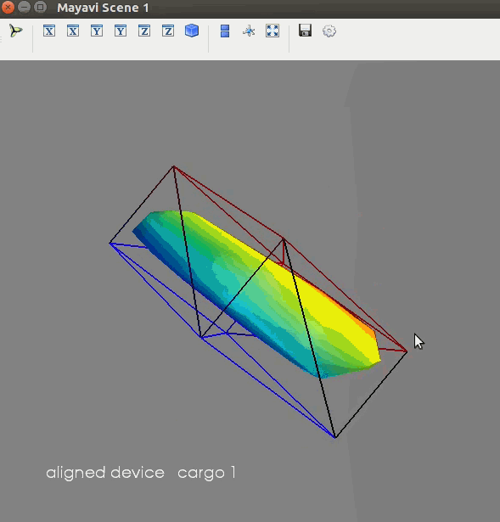
Quality Assessment
Output Demo:

Slide 19
Engineering Analysis
Object 1 | Original Value | Tested Value Speed = 0.3m/s | Tested Value Speed = 0.4m/s
Length(cm) | 38 | 40.8 | 41.1
Percent Error |  | 7.4% | 8.2%
Width(cm) | 25 | 27.4 | 26.4
Percent Error |  | 9.6% | 10.5%
Height(cm) | 21 | 20.1 | 20.2
Percent Error |  | -4.3% | -0.5%
Volume(cm^3) | 19,950 | 22,470 | 21,918
Percent Error |  | 12.6% | 9.8%

Slide 20
Engineering Analysis
Object 2 | Original Value | Tested Value Speed = 0.3m/s | Tested Value Speed = 0.4m/s
Length(cm) | 22 | 23.7 | 23.5
Percent Error |  | 7.7% | 6.8%
Width(cm) | 17 | 18.5 | 17.6
Percent Error |  | 8.8% | 3.5%
Height(cm) | 10 | 9.9 | 9.8
Percent Error |  | -1% | -1%
Volume(cm^3) | 3740 | 4340.7 | 4053.3
Percent Error |  | 16.1% | 8.4%

Slide 21
Engineering Analysis
Engineering Specs | Required | Result
Speed of Conveyor Belt | 0.2 ~ 0.5 m/s | 0.4 m/s
Cargo Size Range | 10⨉10⨉10 ~ 50⨉50⨉100 cm3 | 10⨉10⨉10 ~ 40⨉40⨉40 cm3
Process Time | <4s | ~1s
Number of Depth Cameras | 2 | 2
Filming Angle Range | -60° ~ 60° | -60° ~ 60°
Camera Distance | 1m ~ 1.5m | 1m
Max Unilateral Error | 10% | 9.6%
Cost Restriction | 3500 RMB | 3200 RMB

Slide 22
Oversights
Aliasing of Reflection Tape Detection
Only tested for single object detection
No test for consecutive objects
Slight misalignment
Small offset exists in point cloud alignment
Considering only cuboid objects
Cylindrical objects
Irregular shapes

Slide 23
Project Delivery Plan
Conduct continuous test on the true conveyor belt with real-world settings

Slide 24
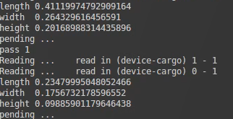
Project Delivery Plan
Design Real Time User Interface
Display the volume of the cargo
Show the point cloud & bounding box in real time

Slide 25
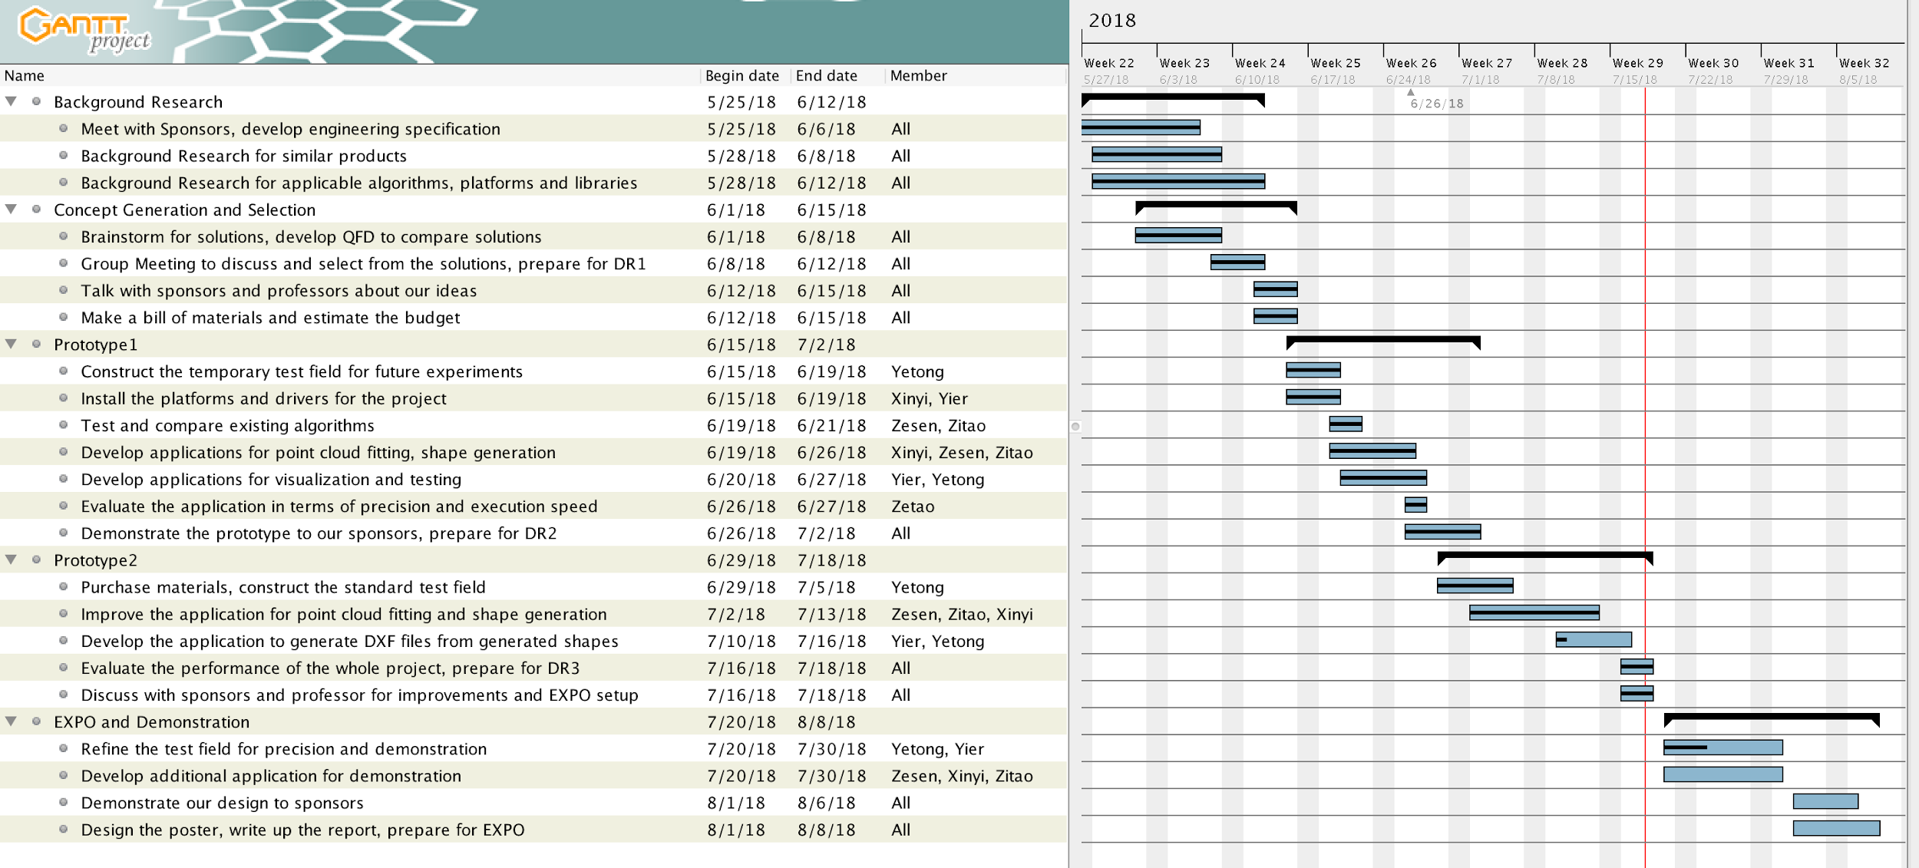
Project Schedule
DR1
DR2
DR3
EXPO

Slide 26
Reference
[1] Newcombe, Richard A., et al. "KinectFusion: Real-time dense surface mapping and tracking." Mixed and augmented reality (ISMAR), 2011 10th IEEE international symposium on. IEEE, 2011.
[2] J. Loera, J. Rambau and F. Santos (2010), Triangulations: Structures and Algorithms (2nd revised ed.), Springer-Verlag, ISBN 9783642129711 Chapter 3: Polygon Triangulation: pp.103.
[3] Besl, Paul J.; N.D. McKay (1992). "A Method for Registration of 3-D Shapes". IEEE Trans. on Pattern Analysis and Machine Intelligence. Los Alamitos, CA, USA: IEEE Computer Society. 14 (2): 239–256. doi:10.1109/34.121791
[4] Pirovano, Michele. "Kinfu–an open source implementation of Kinect Fusion+ case study: implementing a 3D scanner with PCL." no. October 2012 (2011).
[5] Kakinoki, Yoshikazu, Masato Nakashima, Tetsuo Koezuka, Noriyuki Hiraoka, Hiroyuki Tsukahara, Yoshinori Suto, Yoshitaka Oshima, and Shinji Hashinami. Optical System for Detecting Three-dimensional Shape. Fujitsu Ltd, assignee. Patent US5004929A. 2 Apr. 1991. Print.
[6] Itsuzaki, YasuoYoshihiro, Masatoshi Nakamura, Noriyuki Suzuki, Misuzu Takano, and Kinji Horikami. Shape Detection Apparatus. Panasonic Corp, assignee. Patent US5995663A. 30 Nov. 1999. Print.
[7] Nakagawa, Yasuo, and Shree Nayer. Method of Detecting Solid Shape of Object with Autofocusing and Image Detection at Each Focus Level. Hitachi Ltd, assignee. Patent US5151609A. 29 Sept. 1992. Print.
[8]. Specification for “Heavy Duty Slider Bed Conveyor - Model TL 42" OAW, 17'-1" long”,
Hytrol Conveyor Company, Inc. http://www.cisco-eagle.com/catalog/product/12410/
heavy-duty- slider-bed-conveyor-model-tl-42-oaw-17-1-long
[9]. “Kinect for Windows Sensor Components and Specifications” https://msdn.microsoft.com/en-us/library/jj131033.aspx
[10]. K. Khoshelham, S.O. Elberink, “Accuracy and resolution of Kinect depth data for indoor mapping applications”, Sensors, 12:1437–1454, 2012.
[11]. Li, Lingling, Z. Wang, L. Qing, and H. He, “Fast Volume measurement based on Kinect 2.0 depth image”, Microcomputer & Its Applications, vol. 1, no. 7, 2017, pp. 35-38.
[12]. Dellen, Babette, I. Rojas, “Volume measurement with a consumer depth camera based on
structured infrared light”, 16th Catalan Conference on Artificial Intelligence, poster session, 2013, Vic, Spain, pp. 1-10, ACIA.

Slide 27
Presented by Group 17

Slide 28
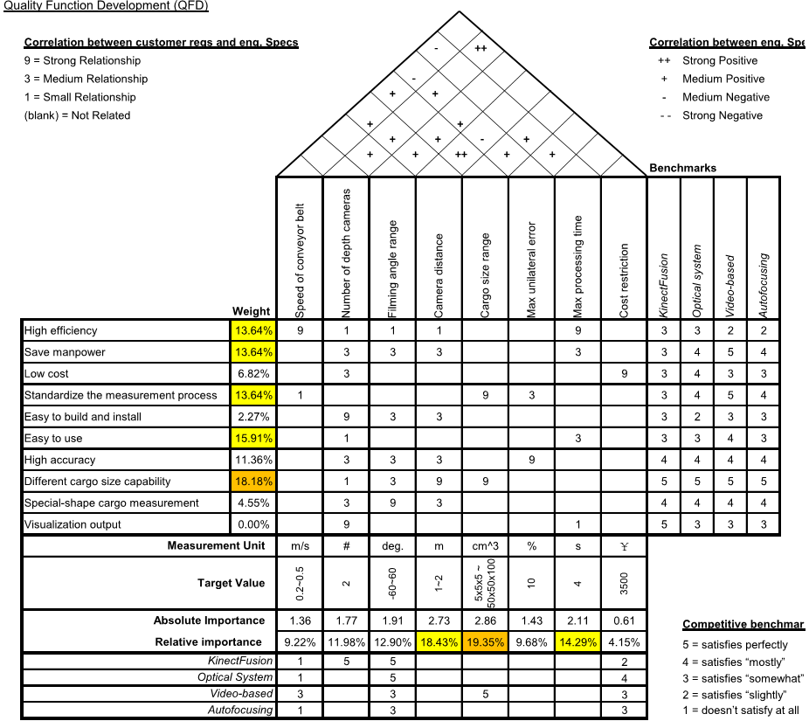
Quality Function Development
-45~45
1~1.5

Slide 29
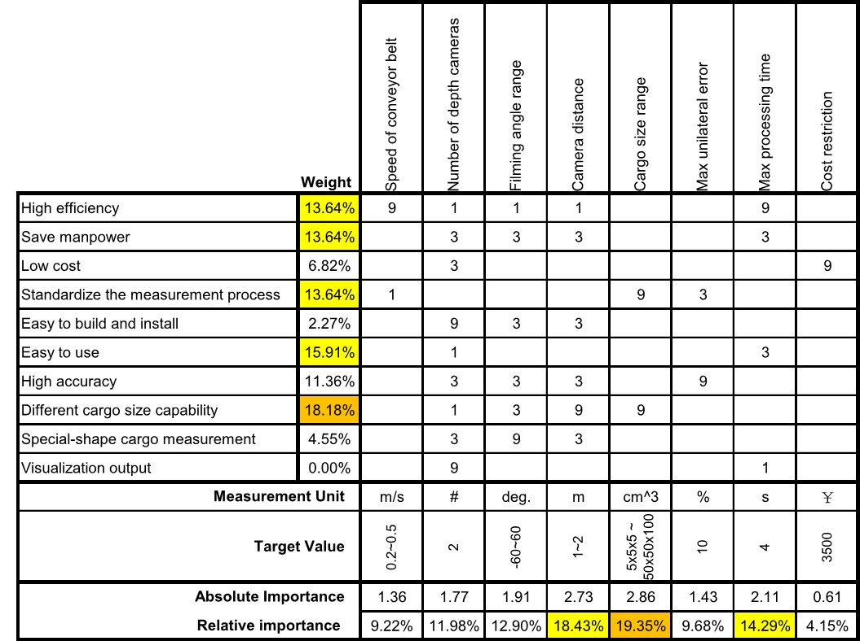
Quality Function Development
-60~60
1~1.5

Slide 30
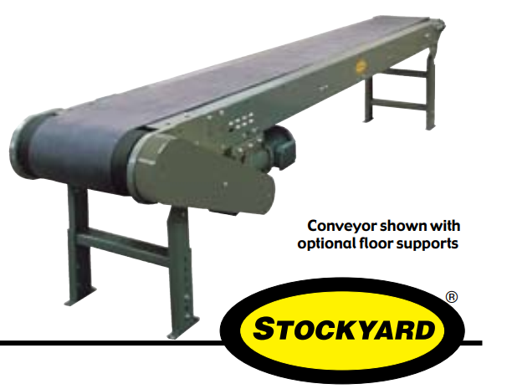
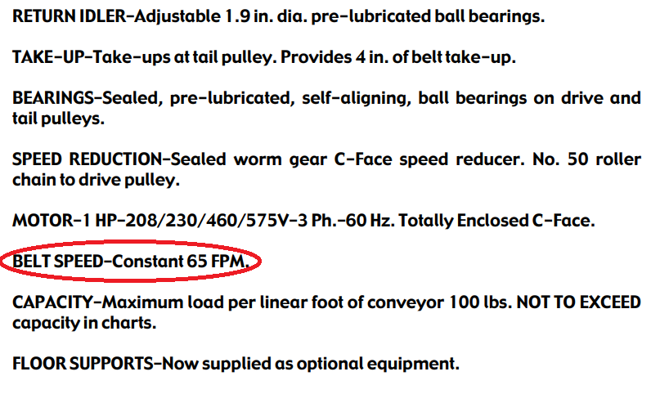
Speed of Conveyor Belt
Heavy Duty Slider Bed Conveyor - Model TL 42" OAW, 17'-1" long
=0.33m/s

Slide 31
Processing Time
2 meters space between two goods
0.5 m/s maximum speed
T_min = 2 / 0.5 = 4s

Slide 32
Cost Restriction
Kinect 2.0 x 2 1488 * 2 = 2976RMB
Camera Support x 2 30 * 2 = 60RMB
Light Reflection Tape 10RMB/m * 20 m = 200RMB

Slide 33
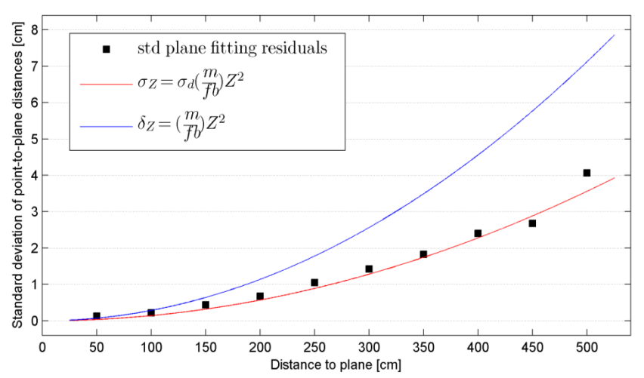
Max Unilateral Error
errors increase quadratically with camera distance
About 0.5 cm deviation at 1.5 m distance
Max unilateral error = 0.5cm/5cm = 10%
“Kinect for Windows Sensor Components and Specifications” https://msdn.microsoft.com/en-us/library/jj131033.aspx

